Slide 1
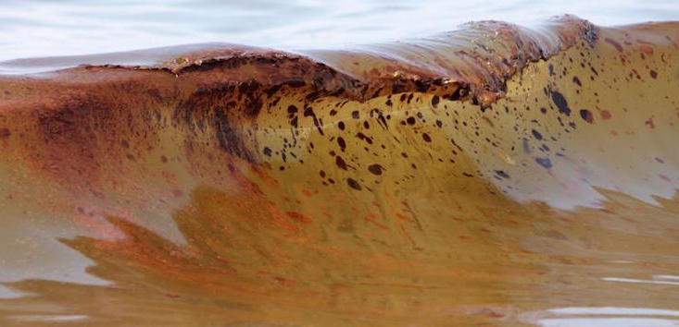
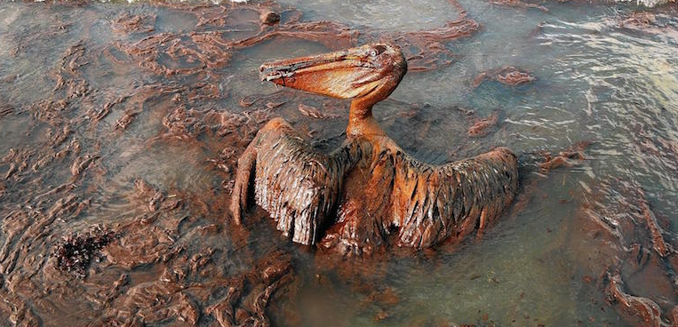
Oil Spill Clean UP And Recovery
STEM PBL Research project

Slide 2
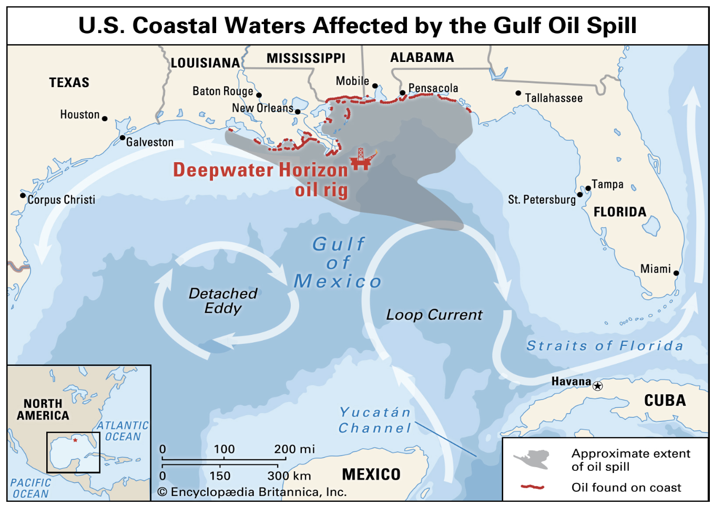
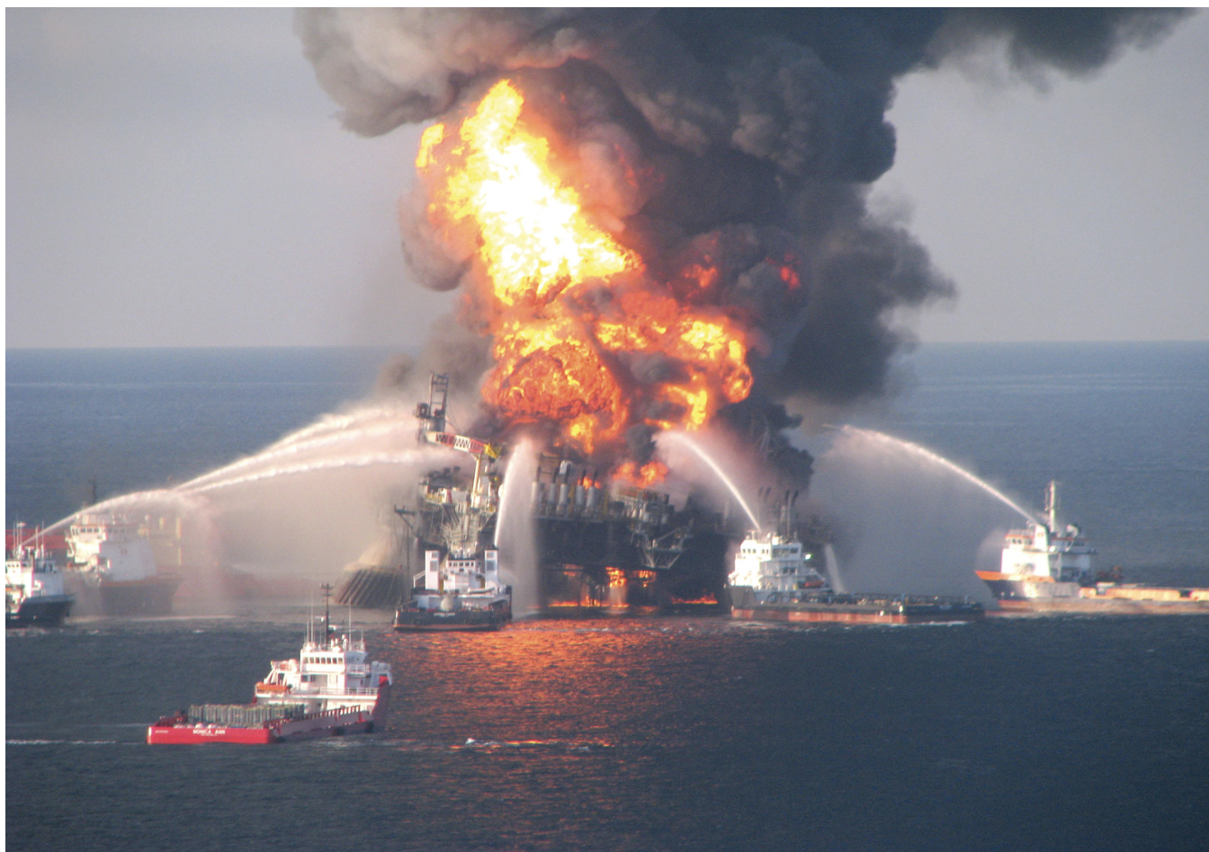
Background information
Oil spills significantly damage ecosystems, kill or endanger the wildlife that live in the affected areas, and even cause substantial economic stress to the communities closest to the spill. These effects last for years or even decades.
Despite increasing interest in alternative energy sources, fossil fuels are still widely used, and oil spills remain a serious threat to marine ecosystems.
4 Years after the BP Deep Horizon Oil Spill

Slide 3
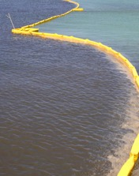
Project overview
Research some of the major methods used for oil spill clean up:
Using oil booms
Using oil skimmers
Oil sorbents
Burning oil in situ
Design and carry out experiments to test oil spill clean up materials, methods, or processes
Assess whether laws relating to oil industries in the U.S. are adequate, and advocate for any changes you feel are appropriate

