Slide 1
Moving Air Masses and Weather March 24
Explain how relationships between the movement and interactions of air masses, high and low pressure systems, and frontal boundaries result in weather conditions and severe storms.

Slide 2
Think about it
Weather changes because of differences in air pressure, movement of fronts, andamount of moisture. Air pressure can be high (H) or low (L), moving fronts can be warm or cold, and air can be humid or dry. There are many different types of weather – warm and sunny, cold and sunny, windy, foggy, warm and rainy, cold and rainy, snow, sleet, hail, tornadoes, hurricanes, and thunderstorms.
How can so many different types of weather occur from a small number of variables?

Slide 3
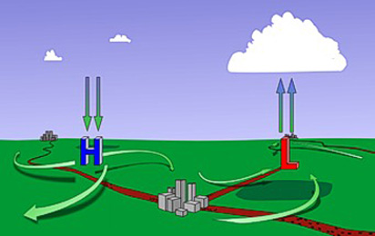
Pressure Systems
We already learned that areas of high pressure form where cold air, which sinks, is found, and low pressure areas form where warm air, which rises, is found. We also know that the differences in pressure cause wind to move air from a high pressure area to a low pressure area. Today we will see that the movement in a high pressure system is different than the movement in a low pressure system.

Slide 4
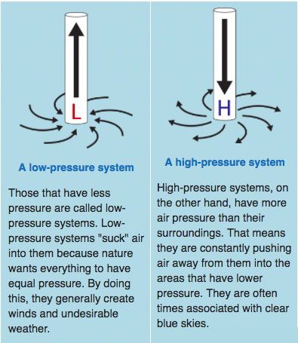
Pressure Systems
High pressure systems are areas where air sinks and moves outward in a clockwise manner (the spinning is due to the Coriolis Effect). The air in the atmosphere is cold, but it gets warmer as it sinks. This makes it absorb moisture from the air at the surface, causing clear skies and mild weather.
Low pressure systems are areas where air moves inward to the low pressure center and then rises. The air moves in the opposite direction as the high pressure air. The air is warm at the surface, but as it rises it becomes colder and causes clouds to form. Low pressure systems cause precipitation.

Slide 5
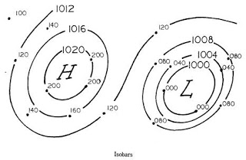
Pressure Systems
When there is little difference between air pressure in an area, the air doesn’t move very much. This allows an air mass to form in the area. The air mass has a specific weather pattern.
When the difference in air pressure between a high pressure system and a low pressure system is big, it gets very windy. Depending on what other factors are present, this can cause severe weather.
isobars
The center of a high pressure trough has higher pressure than the outer areas, because as air moves away, the air pressure decreases.
The center of a low pressure trough has lower pressure than the outer areas. This is why the air moves towards the center - the air pressure outside of the low pressure center is higher.
The numbers on the isobars indicate the pressure

Slide 6
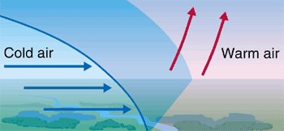
Moving Weather Fronts
When a cold front moves into an area, it causes a drop in the temperature of the area. The cold front is formed by cold air forcing warm air up. The warm air mass is in the area before the cold air mass arrives. The cold air moves the warm air up quickly, which causes a storm instead of just rain.
The slope of the boundary between the two air masses is steep, causing the warm air to rise quickly.

Slide 7
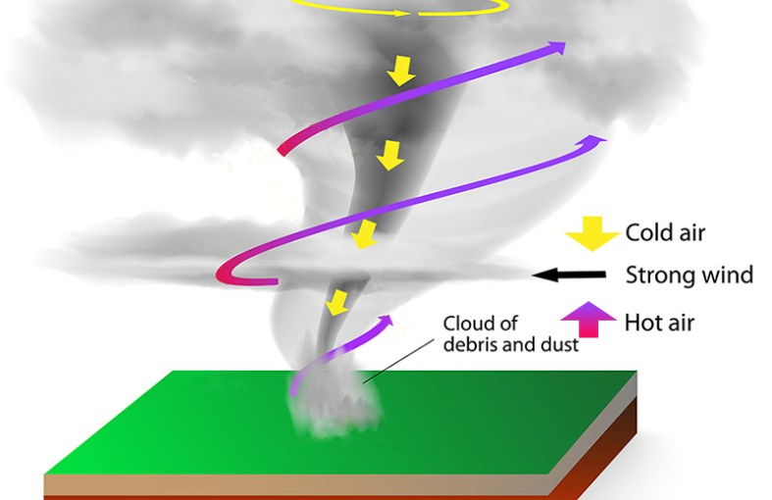
Moving Weather Fronts
If a cold front occurs by combining air masses with really different air pressures, there will be a lot more wind, and the strength of the storm can be much greater. When a thunderstorm encounters strong horizontal winds high in the atmosphere, a tornado forms.

Slide 8
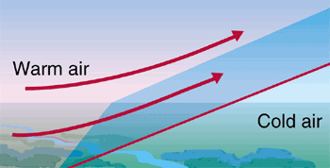
Moving Weather Fronts
When a warm front moves into an area, it causes an increase in the temperature of the area. The warm front is formed by a warm air mass rising over a cold air mass. The cold air mass is already in the area when the warm air mass arrives. The warm air moves up calmly over the cold air. The result is steady rain, sometimes for long periods, but without storms.
The slope of the boundary between the two air masses is gradual, allowing the warm air to rise slowly.

Slide 9
Summary of Moving Air Masses and Weather
Air pressure plays a strong role in understanding weather patterns.
Air pressure is related to air temperature and air density.
Air in a high pressure system moves the opposite of air in a low pressure system.
The larger the difference in the pressure of different air masses at a front, the stronger the winds and weather that results.
Low pressure systems cause precipitation and sometimes storms.
High pressure systems lead to clear, calm weather.
Movement of air masses causes changes in weather.
Cold fronts have a steep slope at the boundary, causing rapid rising of the warm air mass, and leading to storms.
Warm fronts have a gentle slope at the boundary, causing slow rising of the warm air mass, and leading to steady precipitation.

Slide 10
Exit Ticket Question 1
Upload your answers to the 3 questions in the science Padlet. You can put them under your work from last week. The exit ticket WILL be graded, but all scores will be recorded as 80, 90, or 100.
Large cumulonimbus clouds often form along cold fronts. What type of weather is MOST likely to occur along a cold front?
Moderate weather with mild breezes
Steady drizzle
Rain with possible severe thunderstorms
High temperatures with low winds

Slide 11
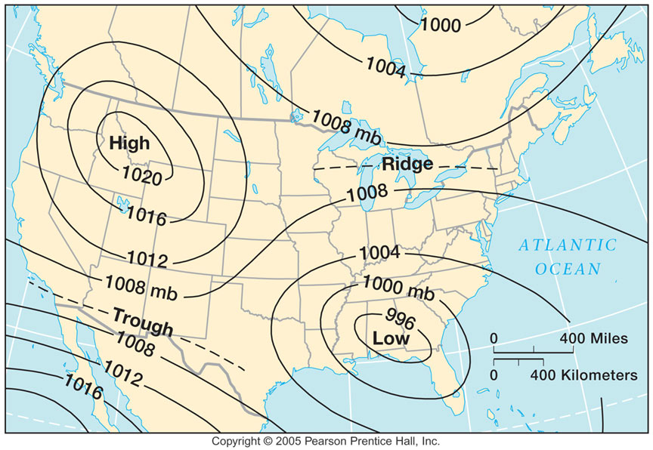
Exit Ticket Question 2
What part of the weather map below is most likely to have calm, clear skies?
The center of the high pressure area
The center of the low pressure area
The space between the two pressure systems
The outer ring of the low pressure area

Slide 12
Exit Ticket Question 3
Is the area covering Mexico low pressure, or high pressure? Explain how you can tell.
Mexico

