Slide 1
March 31
Preparing for the Location of the Best Climate Debate

Slide 2
March 31 Classwork
You should attend at least 15 minutes of one of the ZOOM sessions today (10:00-11:30, 1:30-3:00, or 4:00-5:00)
Your goal is to complete a draft of your 2 minute statement during “class” today. Drafts MUST be submitted by Thursday 5:00 pm. Submit to this Padlet: https://padlet.com/simmonsjl_ums/dd6qh1hioq2
You should have your answers from the March 30 PowerPoint and paper and pen/pencil available during the ZOOM session.

Slide 3
March 31 classwork
Download the Debate Reflection form from the class website. (Please download it and save it to your iPad, instead of viewing it. This will enable you to complete the form.
You should complete the Pre-project Planning page today and upload it to the science Padlet: https://padlet.com/simmonsjl_ums/gzrw6u3g2s6x (The second page will be completed after the debate.)
You should also have the instructions for the debate open. The instructions are on the class website, and are titled Best Climate Debate.

Slide 4
March 31 classwork
Yesterday you chose a location that you claim to have the best weather and climate (steps 1 and 2 from the Best Climate Debate instructions). Today you will construct your 2 minute statement defending your claim based on the science that controls weather.
Your introduction should state your claim: The best weather and climate is found in ____________________.
Next, tell us just a little bit about the location you chose. What is its latitude and climate zone? Is it coastal or inland? What is its elevation? Are there any other important factors that are important (nearby large lakes or mountains, etc.)?
Now you need to talk science. You should be telling us what the climate is like in your location. You should do this by predicting the climate based on science, NOT by looking up the climate of your area. This is the most important part of the debate, so if you NEED to tell us WHY the climate is the way it is.
Be sure to talk about temperature, precipitation, wind, and humidity (whether the air is dry or moist).
Be sure to talk about latitude, elevation, and whether it is near or far from the ocean or another LARGE body of water.

Slide 5
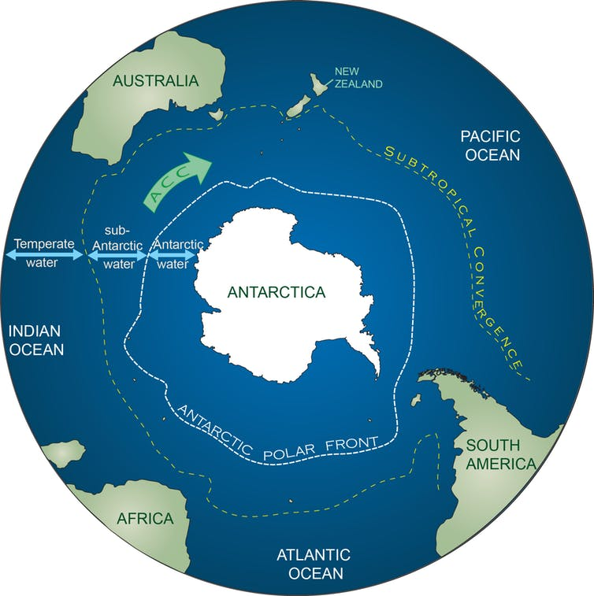
Partial example of 2 minute statement
The best climate in the world is found at the Amundsen-Scott South Pole base in Antarctica. Antarctica covers the South pole (latitude 90S), and is surrounded by LOTS of ocean water, but the Amundsen-Scott South Pole base is inland at the actual South Pole. Because of its location at the South Pole, the temperatures are VERY cold, since this latitude gets much less direct sunlight than latitudes nearer the equator. The base is also far inland, so it is colder than the coastal portions of Antarctica, which are slightly warmer due to heat transfer from the ocean waters. The base is super cold all year long, being part of the polar climate zone, which allows it to remain frozen always.
The elevation of Amundsen-Scott South Pole base is 9300 ft, and it is part of a flat plateau. The Polar Easterly winds of the southern hemisphere originate in this area, and the lack of geographic features or buildings allows the winds to be uninterrupted for hundreds of miles.
The base is located at a fixed high pressure zone, due to the very cold temperatures, which makes the air very dry. There is little precipitation that occurs because of this, since the air cannot hold much water at these temperatures and air pressures. Being far inland also reduces the amount of water that is found in the air, so the humidity is quite low.

Slide 6
Tips for your 2 minute statement
The example on slide 5 is meant to help you format your 2 minute statement. Note that the focus was on the science, and explaining the climate. The climate you prefer (warm/cold/moderate, rainy or dry) is not being judged, only your ability to describe the science behind the climate.
Note the references to latitude, elevation, and closeness to water in my example. You should cover this, too.
Note the discussion of temperature, precipitation, wind, and humidity. You should also include a similar discussion in your statement.
Note that I included figures. These can help your audience to understand, but can also help you to explain. I would have pointed to the maps if I had actually been presenting via ZOOM, and I may have had a picture of the flat, frozen Antarctic plateau where the base is found.

Slide 7
Debate information
During the ZOOM session, I can give you verbal feedback on a draft of your statement. You can upload it to the new Padlet for ”classwork”: https://padlet.com/simmonsjl_ums/dd6qh1hioq2
Everyone should upload a draft of the 2 minute statement no later than Thursday 5:00 pm. I will only provide written feedback if I am concerned with your work. Remember that a draft just means a version – you can still make changes after this point.
The 2 minute statement is the main part of the debate, but you will also get to respond to the other debate members after everyone has presented. Preparing for the response portion means KNOWING the science content well enough to question evidence that is presented by someone else, or to be able to add more details about climates – either to lobby for your location’s climate, or to lobby against the climates of the other locations.
If you have questions about the debate, you should ask no later than Friday, April 3. Debates will be held on Monday, April 6 and Tuesday, April 7. The debate schedule will be posted by Thursday, April 2. If you are unable to participate by ZOOM or at your scheduled time, you need to let me know by Thursday 8:00 pm.

