Slide 1
Weather and Climate Data March 26
Analyze and interpret data from weather conditions, weather maps, satellites, and radar to predict probable local weather patterns and conditions.

Slide 2
Climate vs. Weather
Weather and climate are related, but different. Both describe the temperature and precipitation experienced in an area, as well as other factors, such as wind and humidity.
Weather is less consistent; it is the short-term state of the atmosphere. Weather has significant range, with high and low temperatures within a season that have little effect on the average temperature of the season.
Climate is more consistent; it is the weather conditions in an area over a long period of time. Despite weather fluctuations from day to day, from year to year a location has very similar climate. Climate is based more on patterns than weather.

Slide 3
Probable Local Weather Patterns
Data is used to determine the climate of an area, as well as to make weather predictions.
For the climate of an area, data for years are averaged, such as average monthly precipitation for an area. Although some years might be drier or wetter than usual, we expect that it will be similar to this average amount. Climate can be thought of as a description of average weather history for the area.
For the weather of an area, only recent measurements are helpful. What happened last year at this time may be quite different than what is happening this year. Predicting weather is more complex, and requires many pieces of information, not simply the temperatures or rainfall amounts for the past 3 days.

Slide 4
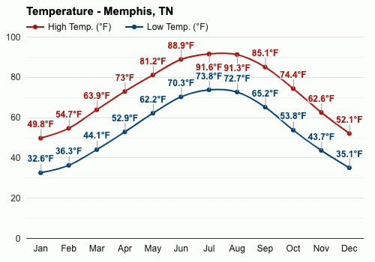
Probable Local Weather Patterns
The climate of Memphis is described by several factors, such as average high and low temperatures. This is shown in the following graph.
Based on this graph, what would you expect the high temperature to be in June?
Based on the climate data, you could predict that the high temperature would most likely be between 85-92ºF.

Slide 5
Probable Local Weather Patterns
In contrast, the weather in Memphis cannot be predicted from the graph of average high temperatures. It might not even be helpful to know the high temperature for the last 3 days, because a cold or warm front could move into the area.
Weather has different types of patterns than climate. These include how a cold front affects an area, how a warm front affects an area, and how high and low pressure systems affect an area.

Slide 6
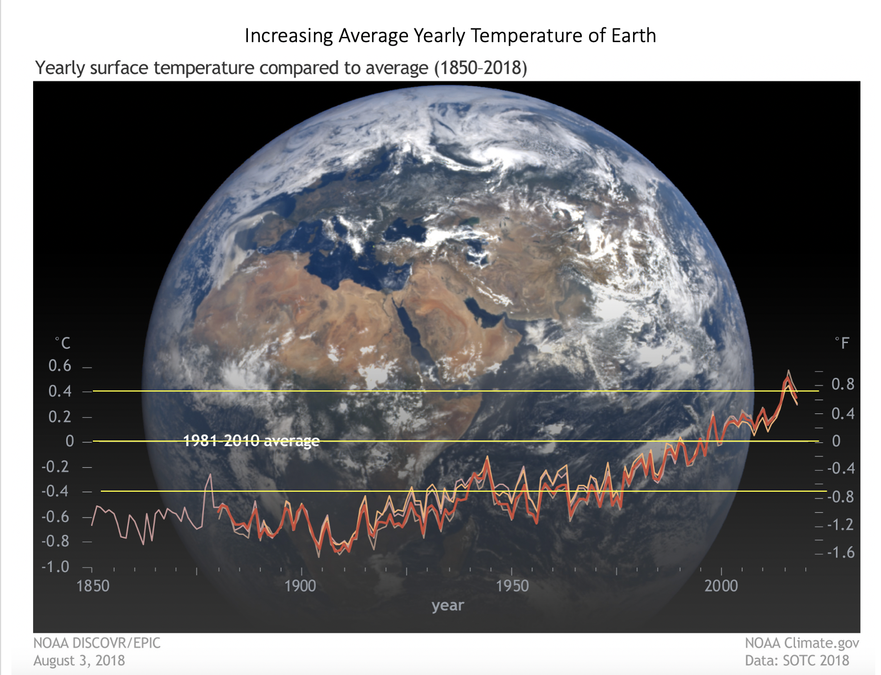
Analyzing and Interpreting Weather Data
By looking at patterns in weather data, we can notice if weather patterns are changing, as in climate change.
By comparing the average surface temperature of Earth from 1850-2018, it is clear that the surface temperature has increased.

Slide 7
Analyzing and Interpreting Weather Data
Now we will analyze some real climate data for Memphis in order to identify the probable weather patterns. The following describes our purpose.
A farmer from the Memphis area is considering new crops to grow. The farmer compares the growth requirements of sweet potatoes, sugarcane, and asparagus. Use the weather data for Memphis and the growth needs of each plant to determine which plant is most suitable to grow in the Memphis area.

Slide 8
Analyzing and Interpreting Weather Data
A farmer from the Memphis area is considering new crops to grow. The farmer compares the growth requirements of sweet potatoes, sugarcane, and asparagus. Use the weather data for Memphis and the growth needs of each plant to determine which plant is most suitable to grow in the Memphis area.
Months | Jan | Feb | Mar | Apr | May | Jun | Jul | Aug | Sep | Oct | Nov | Dec
Avg High Temp (º F) | 50 | 55 | 64 | 73 | 81 | 89 | 92 | 91 | 85 | 74 | 63 | 52
Avg Precipitation (in) | 3.98 | 4.39 | 5.16 | 5.50 | 5.25 | 3.63 | 4.59 | 2.88 | 3.09 | 3.98 | 5.49 | 5.74
Plant Type | Sweet Potato | Sugarcane | Asparagus
Growing Temperature Range (º F) | 75-95 | 85-95 | 70-80
Monthly Precipitation needed (in) | 3-4 | 7-9 | 5-8
Number of months required | 4 | 7-8 | 4

Slide 9
Analyzing and Interpreting Weather Data
A farmer from the Memphis area is considering new crops to grow. The farmer compares the growth requirements of sweet potatoes, sugarcane, and asparagus. Use the weather data for Memphis and the growth needs of each plant to determine which plant is most suitable to grow in the Memphis area.
Months | Jan | Feb | Mar | Apr | May | Jun | Jul | Aug | Sep | Oct | Nov | Dec
Avg High Temp (º F) | 50 | 55 | 64 | 73 | 81 | 89 | 92 | 91 | 85 | 74 | 63 | 52
Avg Precipitation (in) | 3.98 | 4.39 | 5.16 | 5.50 | 5.25 | 3.63 | 4.59 | 2.88 | 3.09 | 3.98 | 5.49 | 5.74
There ARE enough months with the right temperature
Plant Type | Sweet Potato | Sugarcane | Asparagus
Growing Temperature Range (º F) | 75-95 | 85-95 | 70-80
Monthly Precipitation needed (in) | 3-4 | 7-9 | 5-8
Number of months required | 4 | 7-8 | 4

Slide 10
Analyzing and Interpreting Weather Data
A farmer from the Memphis area is considering new crops to grow. The farmer compares the growth requirements of sweet potatoes, sugarcane, and asparagus. Use the weather data for Memphis and the growth needs of each plant to determine which plant is most suitable to grow in the Memphis area.
Months | Jan | Feb | Mar | Apr | May | Jun | Jul | Aug | Sep | Oct | Nov | Dec
Avg High Temp (º F) | 50 | 55 | 64 | 73 | 81 | 89 | 92 | 91 | 85 | 74 | 63 | 52
Avg Precipitation (in) | 3.98 | 4.39 | 5.16 | 5.50 | 5.25 | 3.63 | 4.59 | 2.88 | 3.09 | 3.98 | 5.49 | 5.74
Not enough months with the right temperature
Plant Type | Sweet Potato | Sugarcane | Asparagus
Growing Temperature Range (º F) | 75-95 | 85-95 | 70-80
Monthly Precipitation needed (in) | 3-4 | 7-9 | 5-8
Number of months required | 4 | 7-8 | 4

Slide 11
Analyzing and Interpreting Weather Data
A farmer from the Memphis area is considering new crops to grow. The farmer compares the growth requirements of sweet potatoes, sugarcane, and asparagus. Use the weather data for Memphis and the growth needs of each plant to determine which plant is most suitable to grow in the Memphis area.
Months | Jan | Feb | Mar | Apr | May | Jun | Jul | Aug | Sep | Oct | Nov | Dec
Avg High Temp (º F) | 50 | 55 | 64 | 73 | 81 | 89 | 92 | 91 | 85 | 74 | 63 | 52
Avg Precipitation (in) | 3.98 | 4.39 | 5.16 | 5.50 | 5.25 | 3.63 | 4.59 | 2.88 | 3.09 | 3.98 | 5.49 | 5.74
Not enough months with the right temperature
Plant Type | Sweet Potato | Sugarcane | Asparagus
Growing Temperature Range (º F) | 75-95 | 85-95 | 70-80
Monthly Precipitation needed (in) | 3-4 | 7-9 | 5-8
Number of months required | 4 | 7-8 | 4

Slide 12
Analyzing and Interpreting Weather Data
A farmer from the Memphis area is considering new crops to grow. The farmer compares the growth requirements of sweet potatoes, sugarcane, and asparagus. Use the weather data for Memphis and the growth needs of each plant to determine which plant is most suitable to grow in the Memphis area.
Months | Jan | Feb | Mar | Apr | May | Jun | Jul | Aug | Sep | Oct | Nov | Dec
Avg High Temp (º F) | 50 | 55 | 64 | 73 | 81 | 89 | 92 | 91 | 85 | 74 | 63 | 52
Avg Precipitation (in) | 3.98 | 4.39 | 5.16 | 5.50 | 5.25 | 3.63 | 4.59 | 2.88 | 3.09 | 3.98 | 5.49 | 5.74
Not exactly right, but it is pretty close. The sweet potatoes are the best choice for the farmer.
Plant Type | Sweet Potato | Sugarcane | Asparagus
Growing Temperature Range (º F) | 75-95 | 85-95 | 70-80
Monthly Precipitation needed (in) | 3-4 | 7-9 | 5-8
Number of months required | 4 | 7-8 | 4

Slide 13
Exit Ticket
The following passage and questions will ask you to analyze weather data in order to determine the weather patterns. Post your answers on the science Padlet under your column.

Slide 14
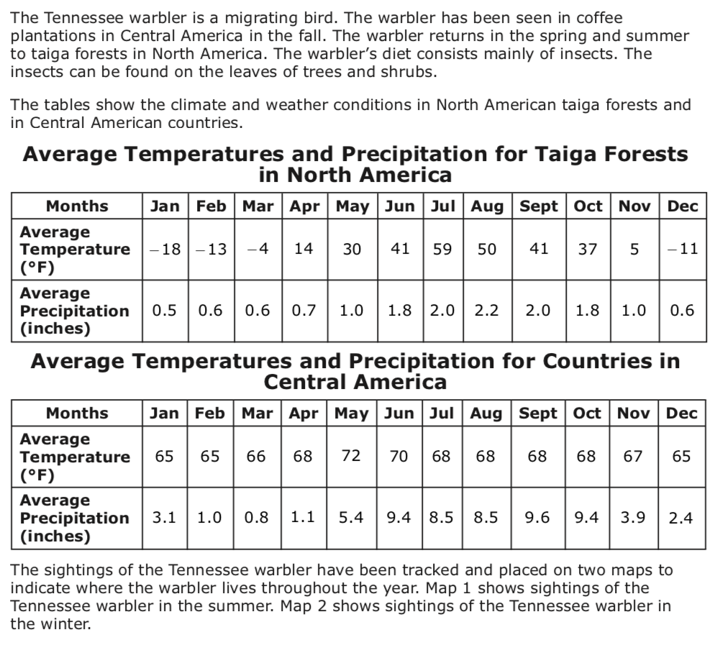

Slide 15
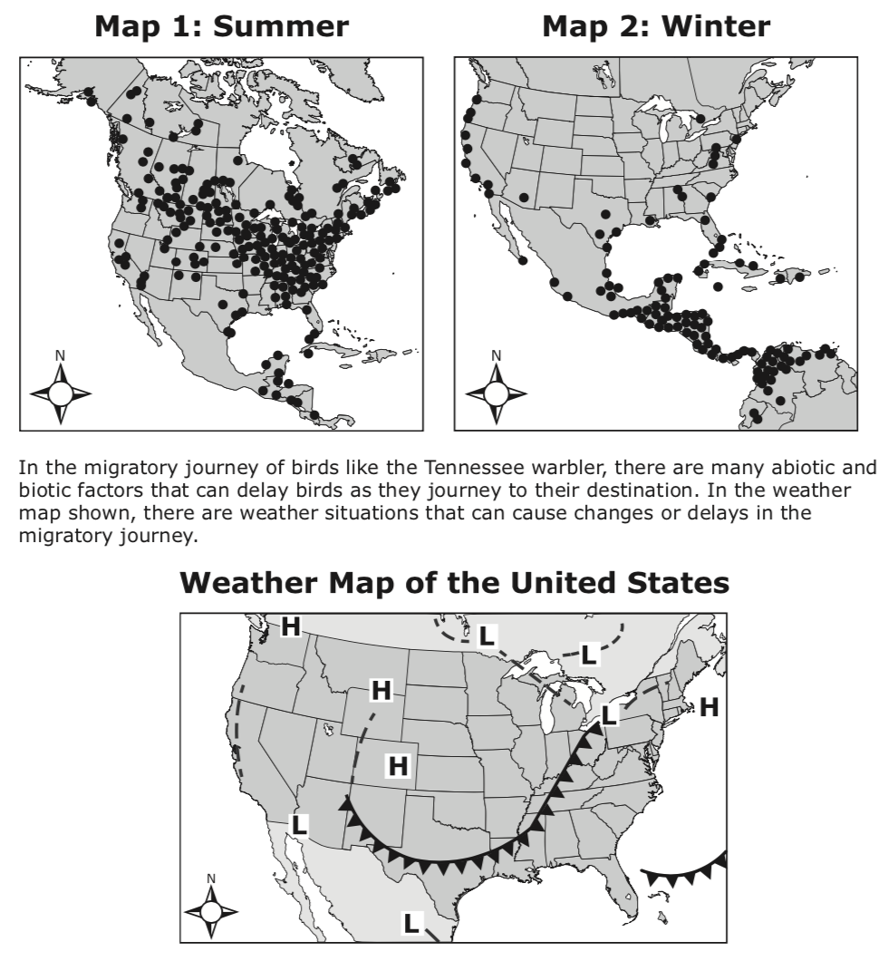

Slide 16
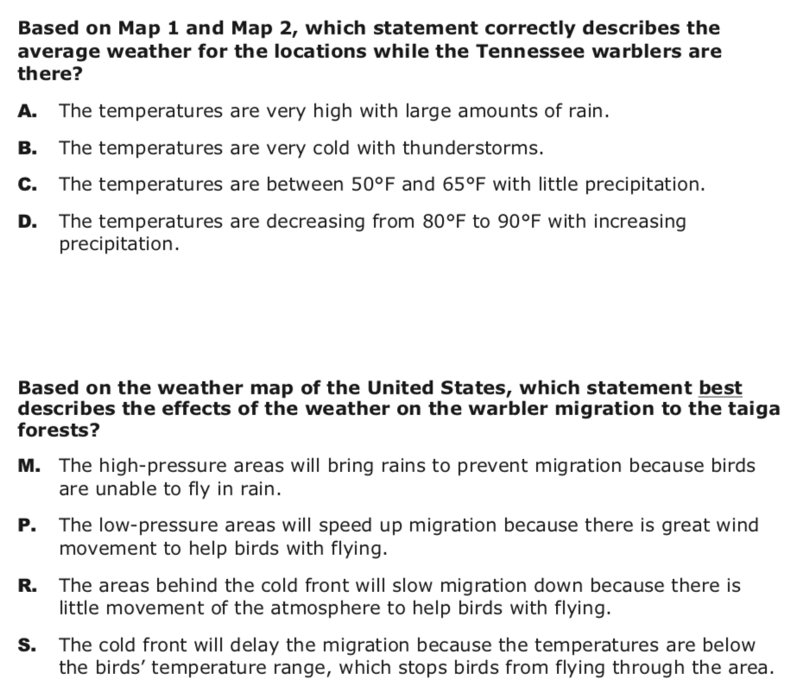
1.
2.

