Slide 1
Intro to Predicting Weather March 25
Analyze and interpret data from weather conditions, weather maps, satellites, and radar to predict probable local weather patterns and conditions.

Slide 2
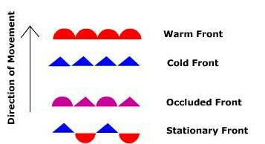
Interpreting a Weather Map
Symbols are used to create weather maps for weather forecasting. Different types of symbols represent different types of information.
Weather fronts are represented by different types of lines
A warm front is indicated by a red line with half circles.
A cold front is indicated by a blue line with triangles.
A stationary front is indicated by a line with alternating red half circles and blue triangles
An occluded front is purple, but also uses the alternating half circles and triangles (You do not need to know what an occluded front is for our class.)

Slide 3
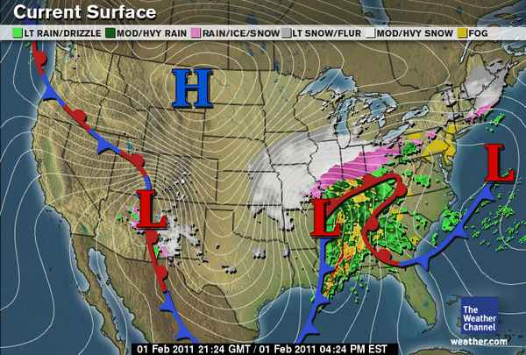
Interpreting a Weather Map
The direction a weather front is moving is indicated by the direction of the half circles or triangles on the line.
This stationary front is not moving, which is what makes it a stationary front.
This warm front (red line) is moving east.
This cold front (blue line) is moving south.

Slide 4
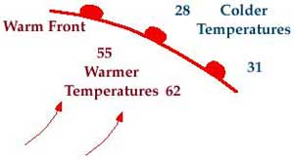
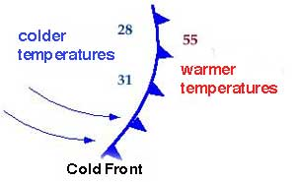
Interpreting a Weather Map
When a warm front moves to a new area, the temperatures in that area increase. This is because the warm front is made of an air mass that is warmer than the air it is replacing.
The warm air is moving to where the cold air used to be.
When a cold front moves to a new area, the temperatures in that area decrease. This is because the cold front is made of an air mass that is warmer than the air it is replacing.
The cold air is moving to where the warm air used to be.

Slide 5
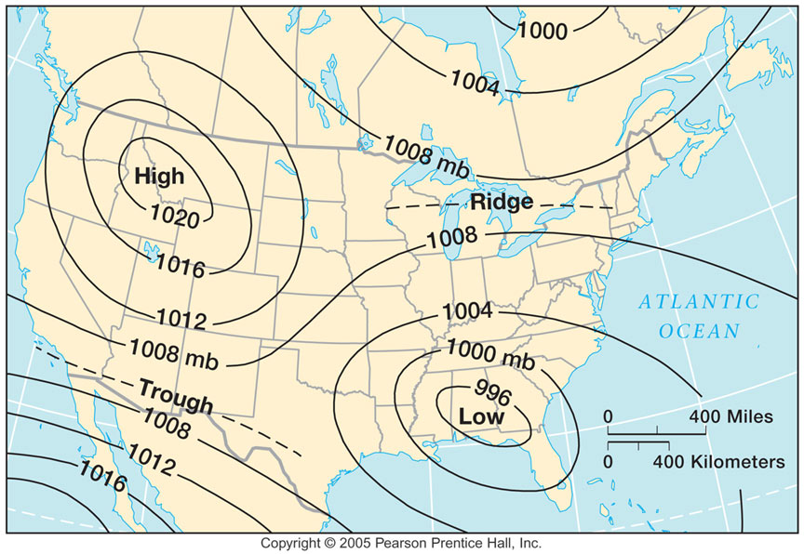
Interpreting Pressure
High and Low pressure centers are marked on weather maps, sometimes with isobars around them
The location of high pressure centers can be used to predict where clear skies will be.
The location of low pressure centers can be used to predict where clouds will form, with some form of precipitation likely.
When isobars are spaced close together, the pressure is changing rapidly.
When isobars are spread farther apart, the pressure is changing more gradually.
Closely spaced isobars
Widely spaced isobars

Slide 6
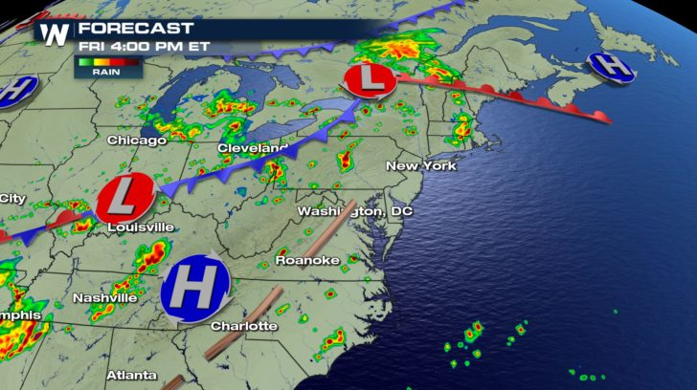
Check for Understanding
Which way is the warm front traveling, towards New York or away from New York?
Which city is closest to the stationary front?
What will happen to the temperature in Washington DC soon (increase or decrease)?s
Based on the current pressure centers, is Charlotte likely to get the rain that is in Nashville?

Slide 7
Check for Understanding
Which way is the warm front traveling, towards New York or away from New York?
Which city is closest to the stationary front?
What will happen to the temperature in Washington DC soon (increase or decrease)?s
Based on the current pressure centers, is Charlotte likely to get the rain that is in Nashville?
The warm front is moving away from New York.
Louisville is closest to the stationary front (it is at the edge of the front).
The temperature in Washington DC should decrease, because the cold front is moving towards Washington DC.
Charlotte is close to the high pressure center. If the high pressure center does not move away, Charlotte probably won’t get the rain that is in Nashville.

Slide 8
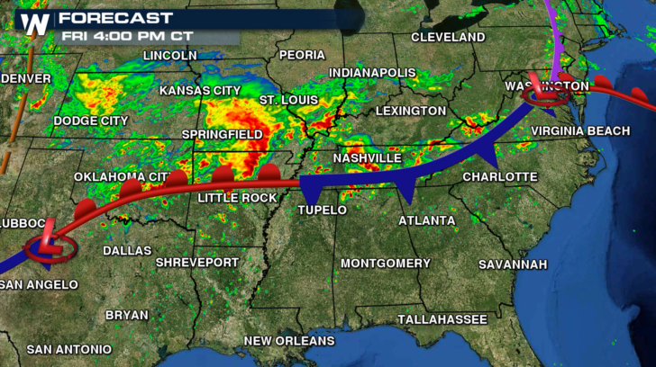
Exit Ticket – post your answers on the Science Padlet
Use the weather map to answer the questions.
Which will experience a cold front soon, Atlanta or Nashville?
What will probably happen to the temperature in Springfield soon? (increase or decrease?)
Would you expect to see an H on this map near Tallahassee or St. Louis?
If the pressure systems don’t change, what kind of weather will Washington DC have next?

