Slide 1
Science March 16-20
Gather evidence to justify that oceanic convection currents are caused by the sun’s transfer of heat energy and differences in salt concentration leading to global water movement.
Construct an explanation for how atmospheric flow, geographic features, and ocean currents affect the climate of a region through heat transfer.

Slide 2
Ocean Currents
March 16-17 (slides 2-10)
Gather evidence to justify that oceanic convection currents are caused by the sun’s transfer of heat energy and differences in salt concentration leading to global water movement.

Slide 3
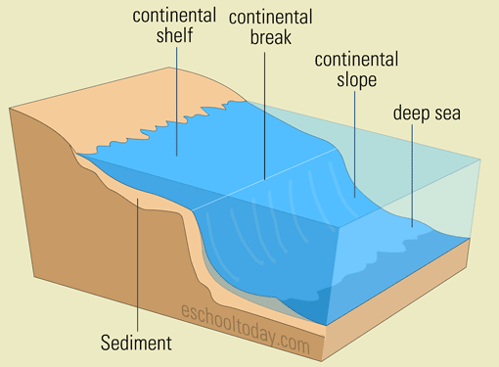
Think about it
The ocean is VERY deep, and sunlight does not pass through the ocean waters to the bottom. ALL of the plants in the ocean are found in the shallow waters of the continental shelf. Since plants provide a lot of food to ocean animals, but most of the ocean does not contain plants, it seems like there shouldn’t be much life in the ocean below the continental shelf, but that is not true.
How is it possible for the ocean to sustain so much life when the deep parts of the ocean do not have plants?

Slide 4
Ocean Currents
Wind moves ocean waters at the surface
Temperature differences move ocean waters – cold water sinks, and warm water rises
Differences in salinity (salt content) move ocean waters – water with high salt sinks, and water with low salt rises

Slide 5
Ocean Convection Currents
Water holds heat better than air, so warm water from near the equator can travel long distances to cold areas and transfer heat to the air in cold areas. After losing heat to the air, the water is colder.
As water cools, it becomes more dense, and sinks. The space left as the cold water sinks is filled in by warmer, less dense water. This type of circulation is called a convection current.
http://www.aquatic.uoguelph.ca/oceans/AtlanticOceanWeb/NACurrents/Causes.htm

Slide 6
Ocean Global Conveyor Belt
The ocean waters circulate due to winds and differences in temperature and salinity.
The circulation follows a predictable path and cycle known as the global ocean conveyor belt.
As the water circulates, it moves thermal energy (from the sun) and matter, such as nutrients and pollution.
https://oceanservice.noaa.gov/facts/conveyor.html

Slide 8
Salinity affects density
Saltwater is more dense than freshwater, so saltwater sinks below freshwater.
Saltwater containing different amounts of salt show this same pattern – saltier water sinks, and less salty water rises.
https://www.youtube.com/watch?v=7fqOtgG6vik
https://oceanservice.noaa.gov/education/tutorial_currents/05conveyor1.html

Slide 9
Ocean Salinity and Currents
Many things can change the salinity of ocean water.
Melting ice dilutes the salt in ocean water
Evaporation removes water, making the water more salty
Freshwater sources drain into the ocean, creating lower salt regions
Differences in salinity cause currents in the ocean that resemble convection currents, even though they are caused by differences in density due to salt, not temperature

Slide 10
Upwelling in the Ocean
Upwelling is a process in the ocean related to ocean currents. Upwelling brings DEEP ocean waters to the surface, increasing the circulation of ocean water.
Upwelling is important because it moves the nutrients found deep in the ocean to the surface, where they are needed. This enables the small amount of ocean water that is used by plants and most other marine organisms to meet the needs of very large and diverse populations.
https://oceanservice.noaa.gov/facts/upwelling.html

Slide 11
Heat Transfer and Climate
March 18-20 (slides 11-21)
Construct an explanation for how atmospheric flow, geographic features, and ocean currents affect the climate of a region through heat transfer.

Slide 12
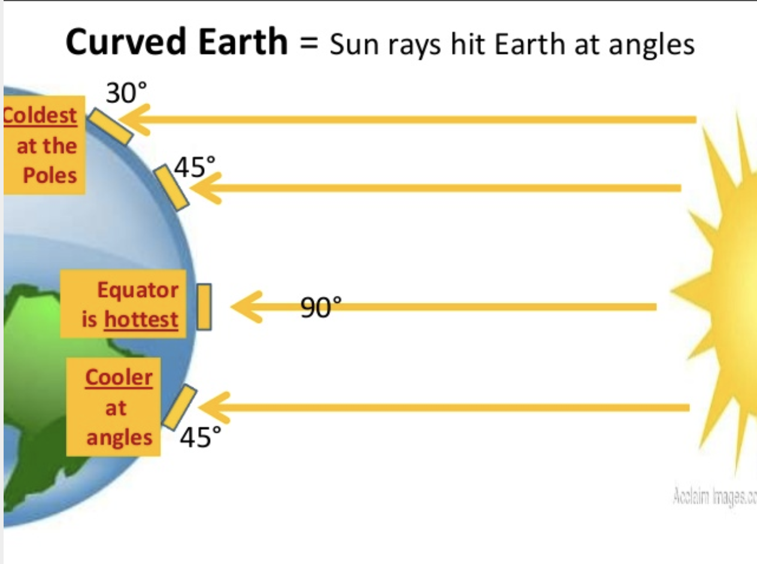
Review of Atmospheric Flow
The Earth is unevenly heated by the sun. The equator gets the most direct sunlight, and the poles get the least direct sunlight. This makes the air near the equator much hotter than the air near the poles.
Air is constantly moving around the Earth, even when there isn’t any wind. This allows for air to change the temperature of an area.

Slide 13
Review of Atmospheric Flow
Hot air rises, and colder air sinks. This causes convection currents to form in the atmosphere. There are six convection currents: 3 in the northern hemisphere, and 3 in the southern hemisphere.
The convection currents are in predictable patterns and affect winds on Earth. They also influence climate.

Slide 14
Climate
Climate is different than weather.
Climate is the typical pattern of weather over a long period of time.
Climate is mostly determined by temperature and precipitation.
Climate is an important factor for many organisms.

Slide 15
Climate
Climate is affected by several factors:
Latitude (distance from the equator)
Topography and elevation (Earth’s features such as mountains)
Ocean currents and large bodies of water

Slide 16
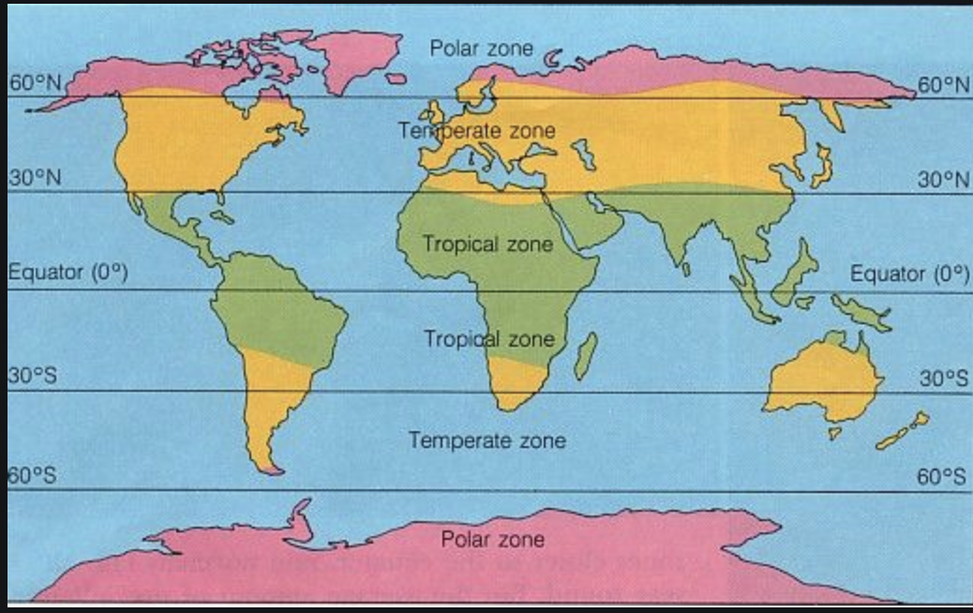
Latitude Affects Climate (Temperature)
There are 3 main climate zones. These are determined by latitude, which influences temperature. This is due to the sun’s uneven heating of the Earth.
Tropical: areas near the equator with high temperatures year round (above 64ºF even in the coldest months)
Temperate: areas between the tropical and polar zones with moderate temperatures. The coldest temperatures are generally below 64ºF and the hottest temperatures are above 50ºF.
Polar: areas near the poles (latitudes of 66.5 or more) with relatively cold temperatures year round. Temperatures rarely get above 50ºF, even in the warmest months.
Latitude lines

Slide 17
Latitude Affects Climate (Precipitation and Wind)
Quick Review:
We already learned that the water cycle is powered by the sun, which causes evaporation. Temperature also influences precipitation
We also learned that wind is caused by areas of high and low pressure, which occur because of uneven heating of the Earth. Air from high pressure bands moves to lower pressure in order to reach equilibrium.
Since different latitudes receive different amounts of sun, there are patterns to the amount of precipitation and wind received at different latitudes.

Slide 18
Topography and Elevation Affect Climate
Topography is defined as the size and shape of the land surface features of a region. Topography varies over the Earth – the Great Plains are very flat and open, and mountain ranges consist of multiple high mountains in a low valley. These features affect climate very differently.
Open plains: Wind does not need to move around hills, woods, etc. This allows the winds to move steadily for long distances before meeting with another wind system. When the wind finally does meet with a different wind system, it is often very different, and results in a higher number of thunderstorms and tornadoes.

Slide 19
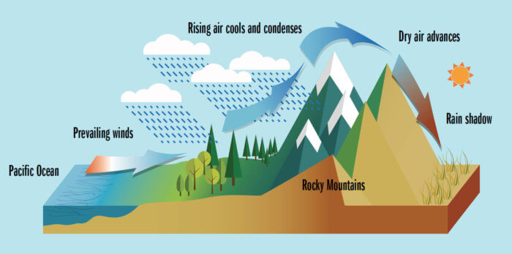
Topography and Elevation Affect Climate
Mountains: Wind must move around mountains, which often means going over the top. As the air rises up the side of the mountain, it cools, forms clouds, and then forms rain (or snow). By the time the air gets to the far side of the mountain, the air is dry. As the air moves back down the mountain, it warms. The warm, dry air on the far side of the mountain favors the formation of deserts.
This effect is called the Rain Shadow Effect. The side of the mountain the wind approaches is wet, and the other side is dry.
Wet side
Dry side

Slide 20
Large Bodies of Water Affect Climate
Water holds heat better than land, so it also changes temperature more slowly than land. In the summer, land heats up more quickly than water. In the winter, land cools off more quickly than water.
Land that is close to a large body of water, such as an ocean or a large lake, does not change temperature as quickly as land that is not near water. The more even temperature of the water keeps the nearby land more even in temperature. Land at the same latitude but farther away from a large body of water will have a wider range of temperatures, because it can cool and heat faster than water.
Coastal areas have milder climates than areas that are not near water. Large bodies of water, such as the Great Lakes, also experience this affect.

Slide 21
Ocean Currents Affect Climate
The ocean has currents that move predictably around the Earth. The system of currents is called the Global Ocean Conveyor Belt. The ocean currents influence temperatures of the coastal areas they contact.
Warm currents flowing from the equator towards the poles move warm water to coastal regions. This water affects the air temperature of the coastal region, making it warmer than air at that latitude would normally be.
Cold currents flowing from the poles towards the equator move cold water to coastal regions. This water affects the air temperature of the coastal region, making it cooler than air at that latitude would normally be.

