Slide 1
Latitude, Wind, and Precipitation
Supplemental Resource to Slide 17 of March 16-20 PowerPoint

Slide 2
Latitude Affects Wind and Precipitation
On slide 17 of the March 16-20 PowerPoint, I stated that there are patterns to the amount of precipitation and wind that occur at different latitudes. This resource provides more details about that claim.
This information should be considered as you develop your Location of the Best Climate science debate statement.

Slide 3
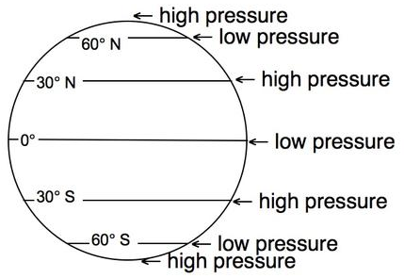
Latitude and Air Pressure Bands
Previously, we learned that the convection cells create bands with low or high pressure. The bands occur as follows.
There are low pressure bands at 60ºC N, 0ºC, and 60ºC S.
There are high pressure bands at the north pole, the south pole, 30ºC N, and 30ºC S.
Notice that the pressure bands alternate.

Slide 4
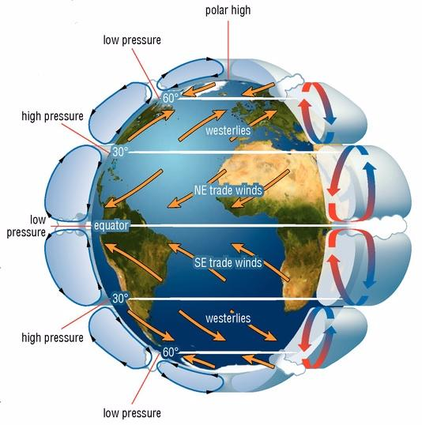
Latitude and Air Pressure Bands
Pressure bands occur where a convection cell starts or ends.
When cold air sinks, it increases the pressure on the Earth, causing a high pressure band to form at that latitude.
When warm air rises, it decreases the pressure on Earth, causing a low pressure band to form at that latitude.

Slide 5
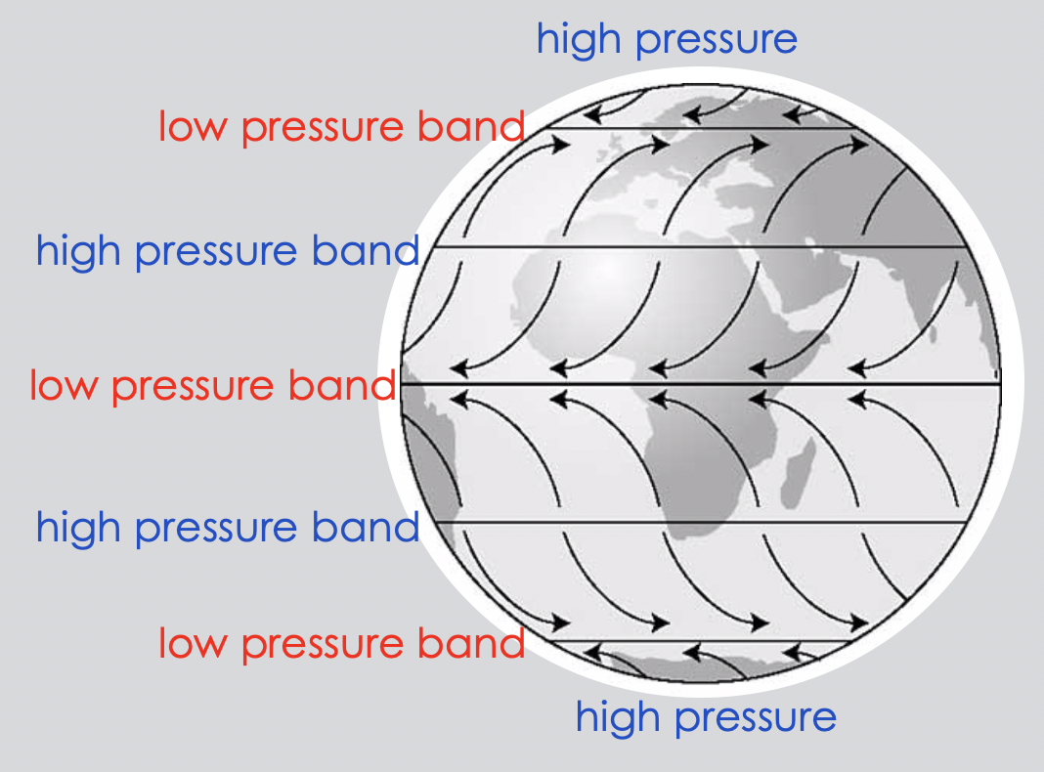
Latitudes and Global Winds
Global Winds are the main belts of wind that move across Earth.
Air always moves from high pressure to low pressure in order to reach equilibrium.
The figure shows that the Global Winds move from a high pressure band towards a low pressure band.
The locations of the pressure bands are fixed at certain latitudes, so the Global Winds are linked to latitude. The pressure bands make the Global Winds predictable.
The winds appear to curve because of the Coriolis Effect.

Slide 6
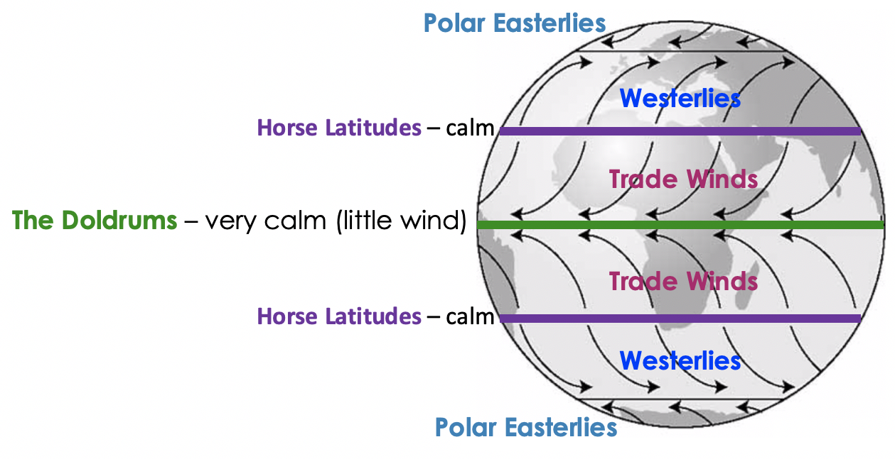
Latitudes and Global Winds
There are 5 types of winds: the Trade Winds, the Westerlies, the Polar Easterlies, the Doldrums, and the Horse Latitudes.
The Doldrums refers to the region at the equator. This is a low pressure band, so wind is expected. However, the strong sunlight at the equator causes the air to rise up, instead of moving across land, resulting in very little wind at the equator.
The Horse Latitudes are often calm, too, because they are at a high pressure band, where air sinks.
The Trade Winds, Westerlies, and the Polar Easterlies all flow from high pressure to low pressure, and produce substantial winds, as expected.

Slide 7
Latitude and Wind Patterns
From slides 3-6, you should now understand that high and low air pressure bands form at specific latitudes, and air pressure bands influence wind patterns.
This means that specific latitudes influence wind patterns.
At a low pressure band, there is usually wind. The only exception is at the equator, known as the Doldrums.
At high pressure bands, there is little wind.
Between pressure bands there are predictable patterns of wind.

Slide 8
Air Pressure Bands and Precipitation Patterns
This content is adapted from: https://serc.carleton.edu/integrate/teaching_materials/mineral_resources/student_materials/unit4supplement.html
Surface air pressure forms bands that align with latitude. This can be seen in the figure below.
Low pressure bands mark where warm air rises and precipitation occurs. For example, due to low pressure, rain forests are found along the equator. (The high temperature also helps, because with high temperatures comes a lot of evaporation, which provides a lot of water vapor to condense to form rain.)
At bands of high pressure, cold air sinks, which prevents condensation. High-pressure bands tend to have low amounts of precipitation; several deserts are located along 30° N and S; the poles also have high pressure and so are also deserts.

Slide 9
Latitude and Precipitation Patterns
You will recall that the Water Cycle involves evaporation of surface water into the atmosphere, where it cools and condenses, forms clouds, and then falls back to Earth as precipitation.
When more evaporation occurs, more precipitation results.
So what increases the amount of evaporation?

Slide 10
Latitude and Precipitation Patterns
As you recall, the sun heats the Earth unevenly. The most direct sunlight is around the equator, making that the hottest region on Earth. The least direct sunlight is near the poles, making them the coldest regions on Earth. How close a location is to the equator or the poles has a lot to do with the temperature of the location.
High temperatures increases the rate of evaporation. Therefore, in hotter latitudes, more precipitation is expected. At the poles (the coldest latitudes), evaporation is so slow that little precipitation occurs.
Oceans contain a lot of water, and are therefore a main source of water for evaporation. Because of this, coastal areas often receive more precipitation than inland areas of the same latitude.
Not all ocean water has the same temperature, however. Coastal areas near warm ocean waters receive higher amounts of precipitation than regions near cold ocean waters.

