Slide 1
April 6 and 7
Analyze and interpret data from weather conditions, weather maps, satellites, and radar to predict probable local weather patterns and conditions.
Explain how relationships between the movement and interactions of air masses, high and low pressure systems, and frontal boundaries result in weather conditions and severe storms.

Slide 2
Agenda for April 6, 7, and 8
Debates are scheduled for Monday, April 6, Tuesday, April 7, and Wednesday, April 8. On the day that you debate, your only other assignment is to complete the post-debate reflection (page 2 of the Debate Reflection form on the class website) and the peer feedback form (also on the class website).
Part One of this lesson is for the first day you are NOT debating. Complete all of the Part One slides and the Part One exit ticket.
Part Two of this lesson is for the second day you are NOT debating. Complete all of the Part Two slides and the Part Two exit ticket.
For instance, if you are scheduled to debate on Tuesday, you would do Part One on Monday, debate on Tuesday, and do Part Two on Wednesday.

Slide 3
Jet Streams Part One
Jet streams are bands of strong wind that generally blow from west to east all across the globe. They impact weather, air travel and many other things that take place in our atmosphere.
From https://scijinks.gov/jet-stream/

Slide 4
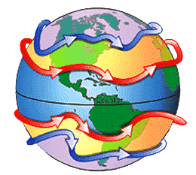
Jet Stream Overview
Watch this short video to gain a basic understanding of what a jet stream is, and what a jet stream does. https://youtu.be/o203JXAnSA0
Polar jet stream
Subtropical jet stream

Slide 5
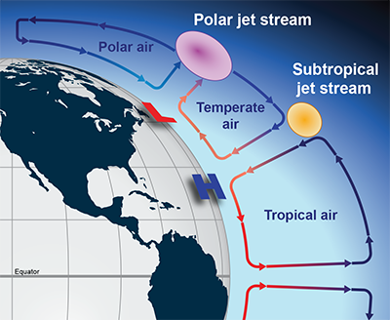
Jet Stream Facts
The jet stream forms because of the uneven heating of Earth, which causes significantly colder air masses at the north and south poles, and significantly warmer air masses near the equator in both hemispheres.
The figure shows the convection cells that are formed as air travels from high pressure (at the poles) towards low pressure (at the equator). The jet streams are located at the pressure bands where 2 convection cells with very different temperatures meet.

Slide 6
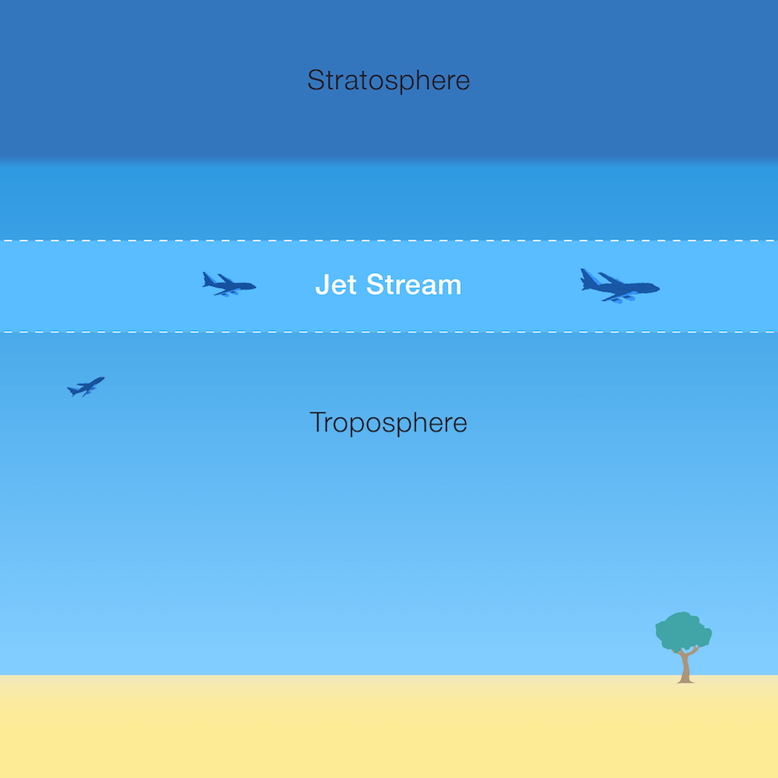
Jet Stream Facts
The jet stream exists in the part of Earth’s atmosphere called the troposphere, at a distance of 5-9 miles above Earth’s surface.
Jet stream winds can blow at speeds up to 250 mph, but average jet stream speeds are 110 mph.
The jet stream can move air masses, high and low pressure systems, and even airplanes.

Slide 7
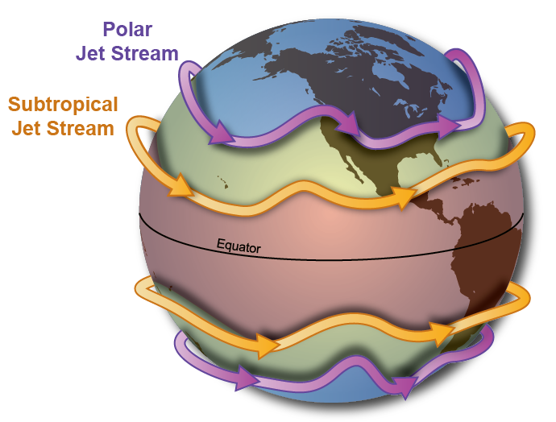
Jet Stream Essentials
There are 4 jet streams on Earth: 2 polar jet streams (one in each hemisphere), and 2 subtropical jet streams (one in each hemisphere). The polar jet stream is most important in the U.S.
Jet stream winds blow west to east, since this is the direction of the Earth’s rotation.
The location of the jet stream can shift up and down based on the season, air temperature, and the locations of high and low pressure systems. This gives a wave-like appearance to the jet stream.

Slide 8
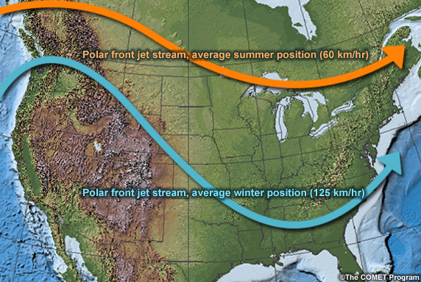
Jet Stream Essentials
In the winter, the polar jet stream shifts closer to the equator.
In the summer, the polar jet stream shifts closer to the poles.
Notice that the wind speeds are higher when the difference between the warm and cold air masses is more extreme (in the winter).

Slide 9
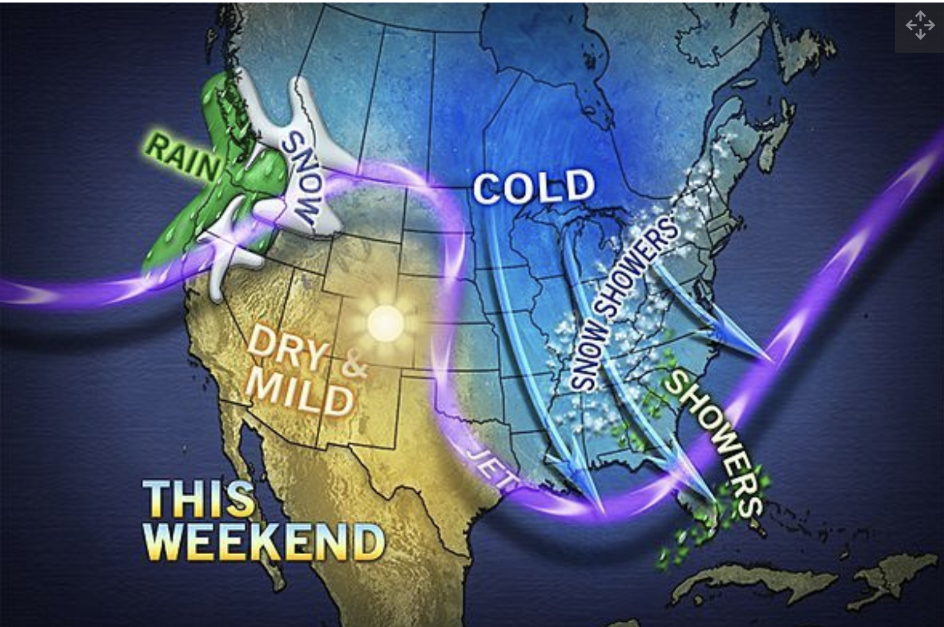
Jet Stream Essentials
The jet stream influences weather.
The jet stream winds blow west to east, since this is the direction of the Earth’s rotation. This means the jet stream pushes weather systems from west to east.
But remember, the jet stream also “dips” up and down as it travels west to east. This can cause changes in normal temperatures, such as a warmer or colder winter weather. Notice how part of the country is getting very cold weather, and part is getting much warmer weather. (Weather map is from March 1, 2013.)
From https://www.livescience.com/27825-jet-stream.html

Slide 10
Jet Stream Essentials
The jet stream separates cold and warm air masses.
Notice that above the jet stream shown on the map, the weather is colder. Precipitation above the jet stream is snow.
Below the jet stream, the weather is warmer. Where there is precipitation below the jet stream, it is rain.
Far from the jet stream, weather often stays in place (this can cause draughts or flooding).
From https://www.livescience.com/27825-jet-stream.html

Slide 11
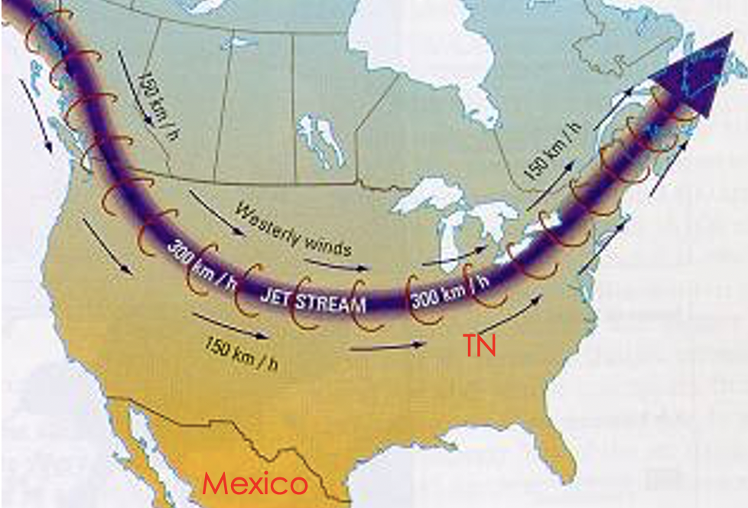
Part One Exit Ticket
Describe the temperatures above the jet stream compared to the temperatures below the jet stream.
Based on the location of the jet stream, is Mexico or Tennessee MORE likely to have unchanging weather?

Slide 12
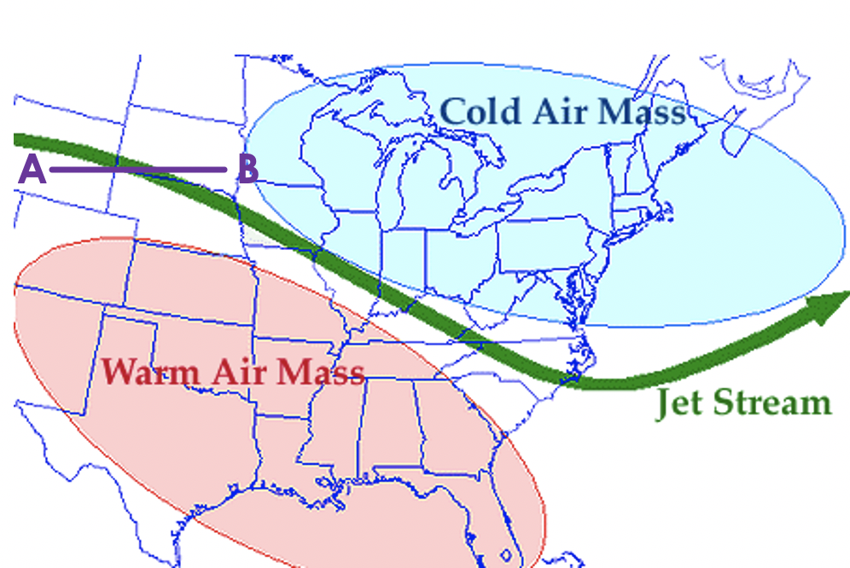
Part One Exit Ticket
Based on the location of the jet stream, is this weather map MOST likely from March, or July?
How does the temperature at point A compare to the temperature at point B?
Which direction is the warm air mass MOST likely to move? (N, S, E, or W?)

Slide 13
Jet Streams Part Two
Applying jet streams to predicting weather.

Slide 14
Predicting Weather Using the Jet Stream
Watch this video explaining how jet streams can change shape: https://www.youtube.com/watch?v=kefYlzHslVI
As the video indicates, the shape of the jet stream changes. This makes it difficult to predict the weather more than a few days in advance.

Slide 15
Predicting Weather Using the Jet Stream
Look at the path of the jet stream. There is precipitation where there are low pressure systems.
Weather moves due to the location of the jet stream. The areas of precipitation follow the path of the jet stream.
It says “cooler” in the southern states below Tennessee. This is because colder air is moving into the area, pushing the warmer air away. This is a cold front.

Slide 16
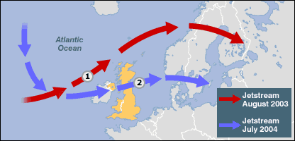
Predicting Weather Using the Jet Stream
The figure shows the position of the jet stream over the United Kingdom during the summers of 2003 and 2004.
In July, 2004 the jet stream was further south than in August 2003. Did this make the summer weather in the United Kingdom warmer in July 2004 or in August, 2003?

Slide 17
Predicting Weather Using the Jet Stream
The figure shows the position of the jet stream over the United Kingdom during the summers of 2003 and 2004.
The jet stream divides the cold air mass from the warm air mass. Therefore, weather above the line is colder, and weather below the line is warmer.
The line is higher in August, 2003, meaning the warm weather extended further north, so the weather was warmer for the United Kingdom in 2003.

Slide 18
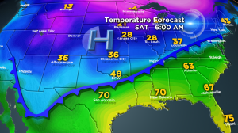
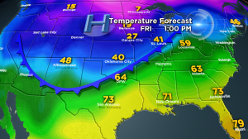
Predicting Weather Using the Jet Stream
Which map is for today if the forecast says that a cold front is moving into Tennessee tomorrow?

Slide 19
Predicting Weather Using the Jet Stream
The map on the right shows Tennessee with warm weather, so that is today. The map on the left shows the cold front just beginning to move into Tennessee.

Slide 20
Part Two Exit Ticket
The exit ticket is on Mastery Connect. The codes are given below:
First period: 286515
Second period: 948189
Third period: 340018
Fourth period: 387984

