Slide 1
Severe Weather
Explain how relationships between the movement and interactions of air masses, high and low pressure systems, and frontal boundaries result in weather conditions and severe storms.

Slide 2
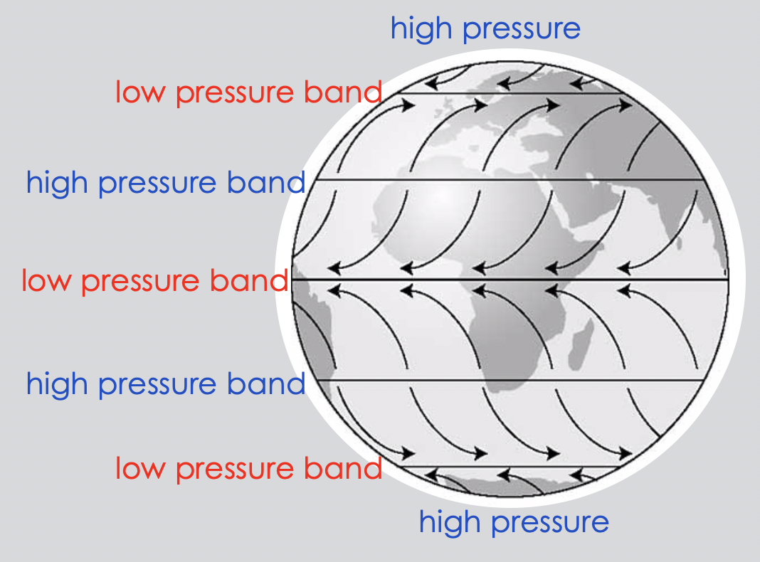
Severe Weather Overview
Severe weather includes but is not limited to: thunderstorms, tornadoes, and hurricanes.
Most of the time, severe weather starts in an area of low pressure, and involves rapidly rising warm air due to clashing air masses, as in a cold front.
To understand thunderstorms, tornadoes, and hurricanes, it is important to understand features of air masses and how they interact (such as cold fronts).

Slide 3
Air Masses and Wind
Remember that air masses form when a large volume of air is still over an area for a long time. To be still, there cannot be much wind in the area.
The air mass takes the temperature and moisture properties of where it forms. This means if it forms over land, it will be dry air, but if it forms over water it will be moist air.
Similarly, if it forms where the temperature is high, it will be warm, and if it forms where the temperature is low, it will be cold.

Slide 4
Air Masses and Wind
There are 4 basic types of combinations that can be made:
OR
OR
OR

Slide 5
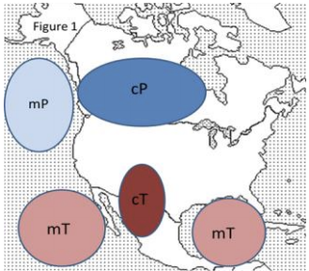
Air Masses and Wind
In the US, the 4 types of air masses are associated with specific latitudes, since latitude influences temperature.
Therefore, they begin at the same locations again and again.
The locations of origin are shown on the map below.
cold latitudes – polar air masses
mP = maritime Polar (moist, cold)
cP = continental Polar (dry, cold)
mT = maritime Tropical (moist, warm)
cT = continental Tropical (dry, warm)
You do NOT need to memorize the names of the air masses, but you DO need to understand this concept of air masses forming according to location.
warm latitudes – tropical air masses

Slide 6
Air Masses and Wind
Once formed, an air mass moves, and this affects the weather in the location the air mass moves to.
Most widespread and significant weather events occur at the boundary of two or more air masses. Examples would include when a cold front meets with a warm front, or a dry air mass meets with a moist air mass.
These significant weather events include thunderstorms, tornadoes, and hurricanes.

Slide 7
Thunderstorms
Three basic ingredients are required for a thunderstorm to form: moisture, instability, and a source of lift.
You already know that low pressure systems cause precipitation. A low pressure system involves warm air rising because it is less dense than the surrounding air. As the air rises into the atmosphere it cools, and the water vapor in the air (moisture) condenses and forms clouds. When the cloud contains too much water, a form of precipitation will occur, such as rain or snow.
However, thunderstorms can result instead of steady rain if
the air is unstable, meaning that it is warmer than the air around it, so that it keeps rising, instead of sinking. This is why thunderstorms are more common in the warm season (summer for the northern hemisphere).
something increases the lift, such as a cold front or mountains. Recall that a cold front makes a warm air mass rise rapidly, whereas a warm front allows the warm air mass to rise gradually. The dramatic rise involved in a cold front often causes thunderstorms. Mountains can provide a similar rapid rise.

Slide 8
Tornadoes
Under the right conditions, thunderstorms can turn into more powerful tornadoes. While not all thunderstorms produce tornadoes, almost all tornadoes form from a thunderstorm.
Watch this video to learn how tornadoes form: https://youtu.be/LT7yRMLAkCY

Slide 9
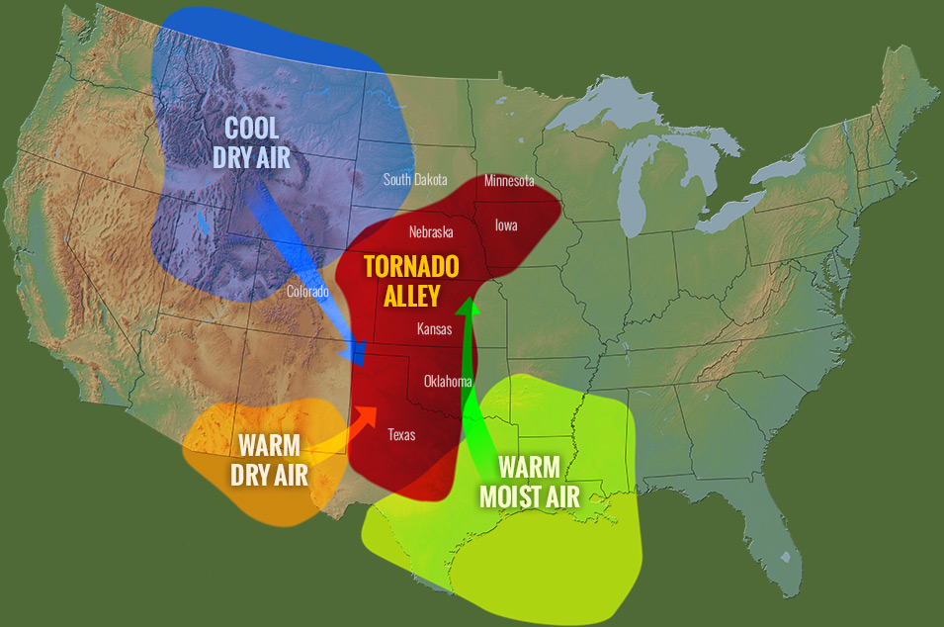
Tornadoes
Some areas are more likely to form tornadoes. The US has the greatest number of tornadoes, many of which occur in a region called Tornado Alley.
Tornado Alley is a region where the cold, dry air mass from the north often meets with the warm, moist air of the Gulf of Mexico, and sometimes the warm, dry air from Mexico, creating a strong “clash” of opposite types of air masses. This helps to produce the winds and lift needed to form tornadoes.

Slide 10
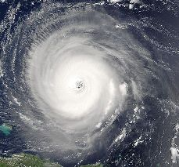
Hurricanes
A hurricane is a large rotating storm with high speed winds that forms over warm waters in the tropical zone. Hurricanes have sustained winds of at least 74 miles per hour and an area of low air pressure in the center called the eye.
Hurricanes also form from thunderstorms, but the thunderstorms must be over water to create a hurricane.
Hurricanes are formed in low pressure areas in warm ocean waters. Initially, the warm, moist air rising because of the warm climate causes storms to form. Due to the Coriolis Effect, the storm clouds will begin to rotate with the spin of the Earth. The heat from the warm water provides enough energy to the storm. If the water is warm enough, the storm and wind speeds will intensify, causing a hurricane to form.

Slide 11
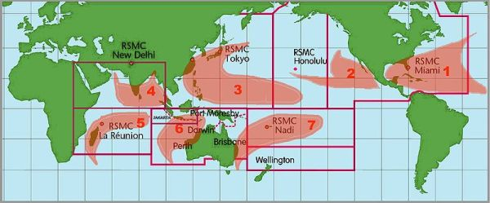
Hurricanes (a.k.a. Tropical Cyclones)
Where do hurricanes/tropical cyclones occur? Tropical cyclones occur over the ocean in areas near the equator. This is because there is plenty of warm water in these areas to allow the storms to form. There are seven major areas in the world that tend to produce tropical cyclones. The map shows the locations of these areas.

Slide 12
Exit Ticket
Test your understanding of air masses by going to IXL. You need to sign in on your iPad. Your parent/guardian should have received an email with your username and password in it. If you need help, I can provide you with this information.
Once you are in IXL, choose the Science tab, then 6th grade, then scroll down until you see DD. Weather and Climate. You should complete the three skills about air masses (Explore air masses, Identify and compare air masses, and How do air masses form?) as your exit ticket.
Be sure to complete your 2 minute statement for the debate and upload it to the “classwork” Padlet by Thursday, 5:00 pm: https://padlet.com/simmonsjl_ums/dd6qh1hioq2

